Slide 1
Topic
Applications of Fuzzy Sets

Slide 2
Applications of Fuzzy Sets
Reasoning tool like Fuzzy Logic Controller
Fuzzy Clustering
Fuzzy Mathematical Programming
Fuzzy Graph theory
Others

Slide 3
Fuzzy Logic Controller (FLC)
Developed by Mamdani and Assilian around 1975
Performance depends on Knowledge Base (KB), which consists of Data Base (DB) and Rule Base (RB)
The performance of an FLC largely depends on the RB and optimizing the DB is a fine tuning process

Slide 4
Two Forms of FLC
Linguistic Fuzzy Modeling: High interpretability and Low accuracy.
Ex: Mamdani Approach
Precise Fuzzy Modeling: Low interpretability and High accuracy.
Ex: Takagi and Sugeno’s Approach

Slide 5
Mamdani Approach
An FLC consists of four modules: Rule Base; Inference Engine; Fuzzification; De-fuzzification

Slide 6
Steps Involved in the Working Cycle of FLC
Identify the condition ( also known as antecedent ) and action (also called consequent) variables of the process
Fuzzification: Measurements of input variables are converted into appropriate fuzzy sets to express measurement uncertainties

Slide 7
Inference Engine uses fuzzified measurements to evaluate the control rules stored in the fuzzy rule base
De-fuzzification: Fuzzified output is then converted into a single crisp value

Slide 8
Fuzzy Reasoning Process
Rule1: IF S₁ is A₁ AND S₂ is B₁ THEN f’ is C₁
Rule2: IF S₁ is A₂ AND S₂ is B₂ THEN f’ is C₂

Slide 9
Let S₁* and S₂* are the inputs for fuzzy variables S₁ and S₂
Firing strengths of the first and second rules can be calculated as follows:

Slide 10
Membership value of the combined control action C is given by

Slide 11

De-fuzzification Methods
where $A(αj)$: firing area of $j$-th rule
$fj$: center of the area
$p$: No. of fired rules
Center of Sums Method

Slide 12
Methods of De-fuzzificztion

Slide 13

Centroid Method
where $N$: No. of small areas or regions
$Ai$: Area of $i$-th small region
$fi$: Center of area of $i$-th small region

Slide 14
Mean of Maxima Method
From the membership function distribution of combined control action, the range of the output variable corresponding to the maximum value of membership is identified. The mid-value of this range is considered to be the crisp output of the controller.

Slide 15
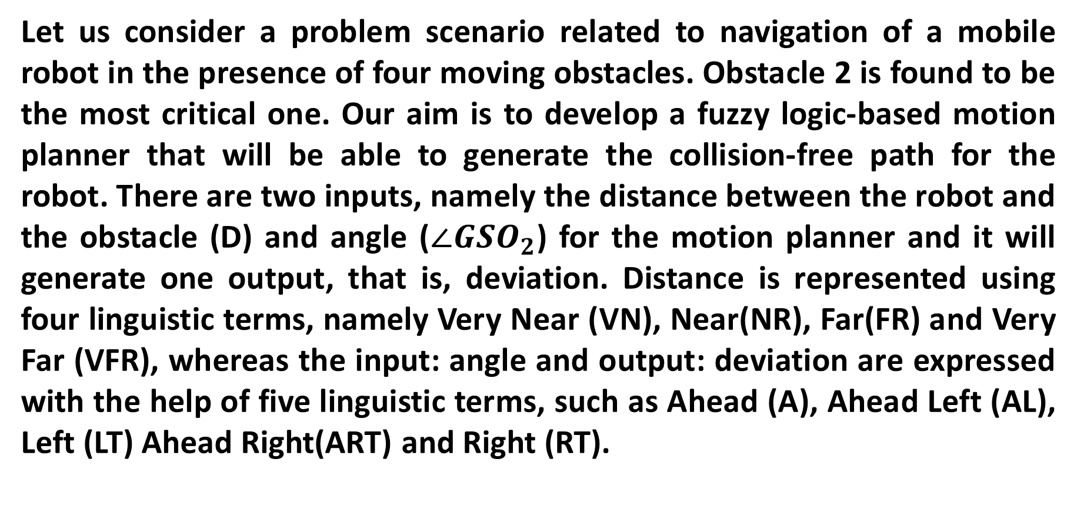
Numerical example (Mamdani Approach)
Let us consider a problem scenario related to navigation of a mobile robot in the presence of four moving obstacles. Obstacle 2 is found to be the most critical one. Our aim is to develop a fuzzy logic-based motion planner that will be able to generate the collision-free path for the robot. There are two inputs, namely the distance between the robot and the obstacle (D) and angle ($∠{GSO}_{2}$) for the motion planner and it will generate one output, that is, deviation. Distance is represented using four linguistic terms, namely Very Near (VN), Near(NR), Far(FR) and Very Far (VFR), whereas the input: angle and output: deviation are expressed with the help of five linguistic terms, such as Ahead (A), Ahead Left (AL), Left (LT) Ahead Right(ART) and Right (RT).

Slide 16
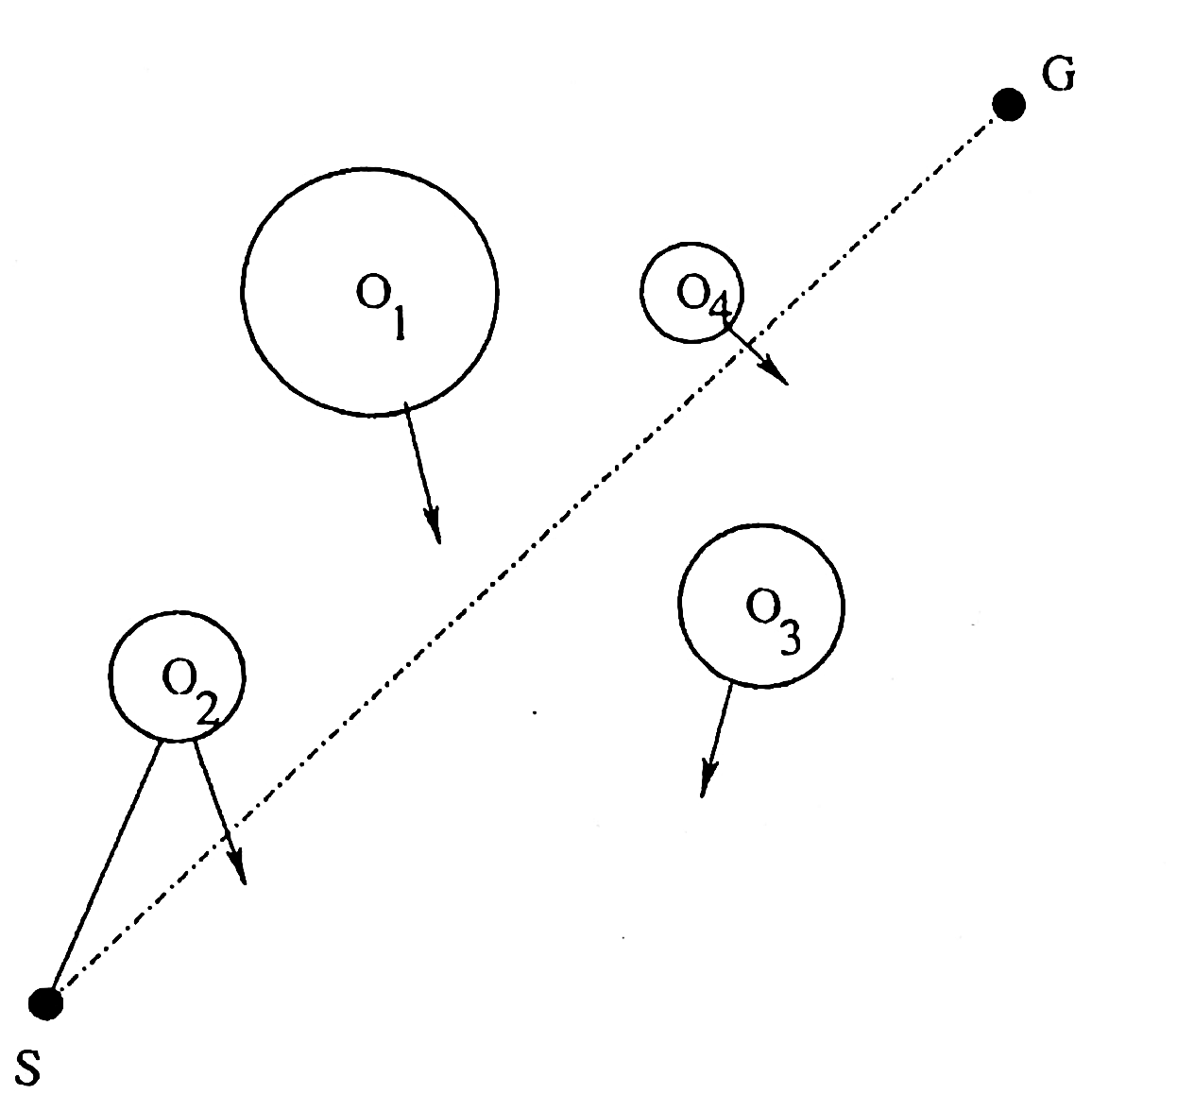

Slide 17
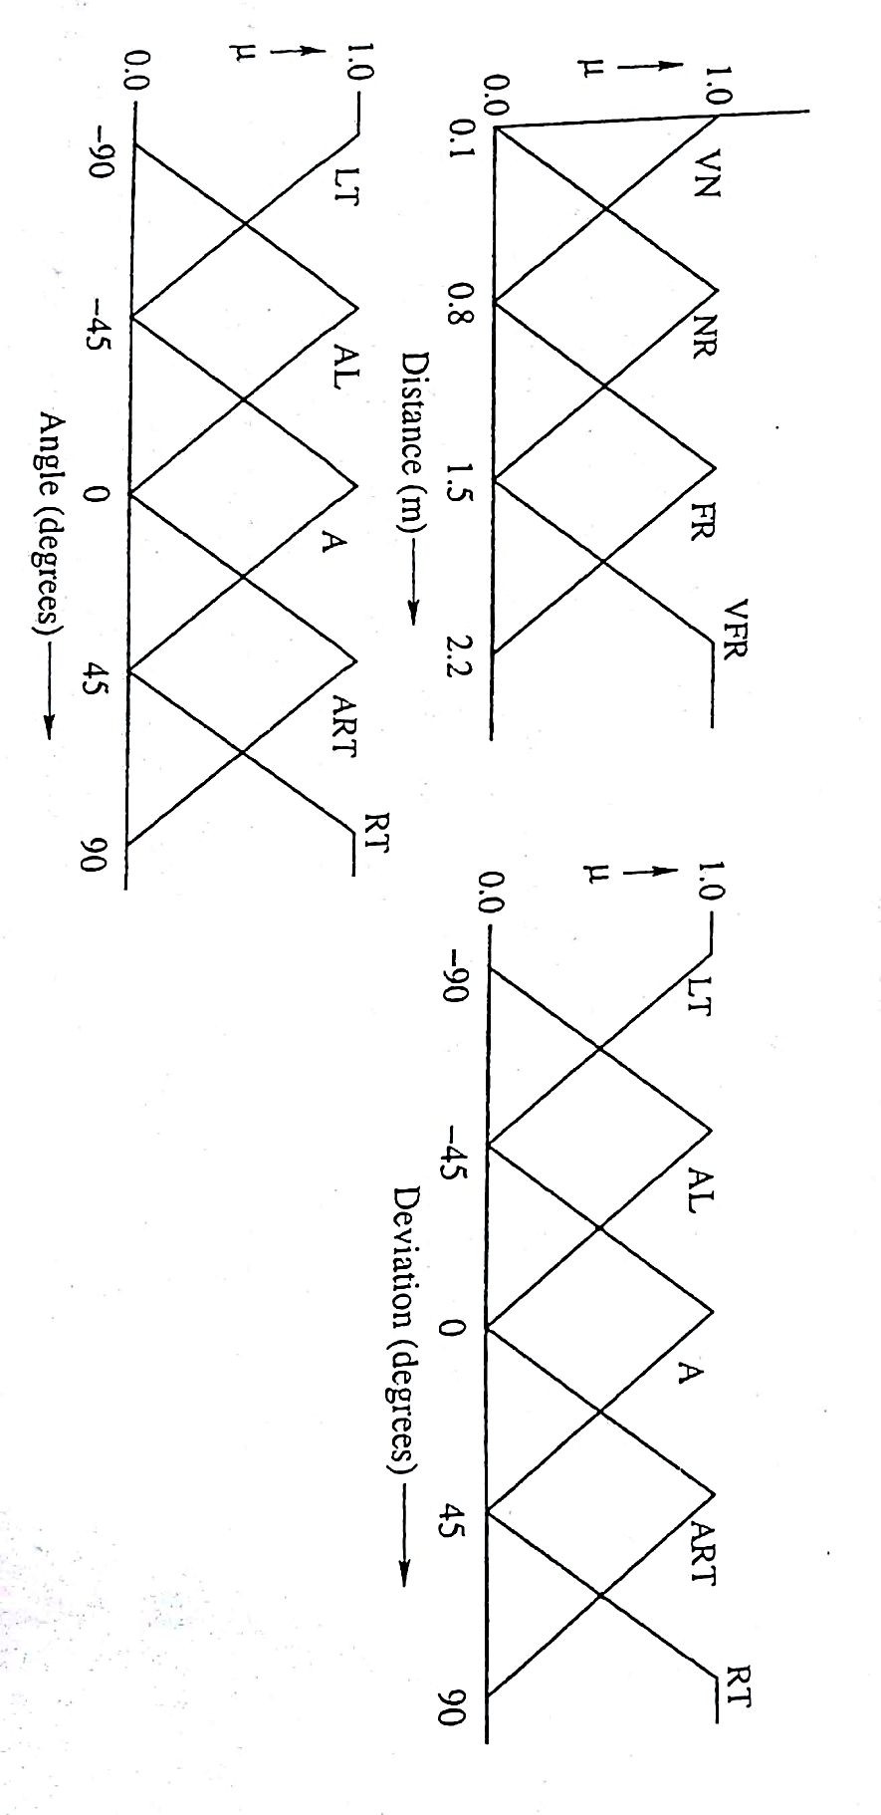
The data base (DB) and rule base (RB) of the FLC are shown below.

Slide 18
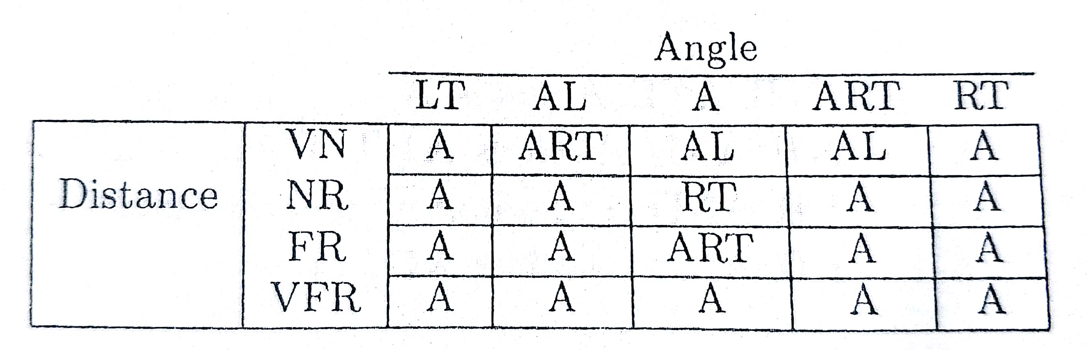
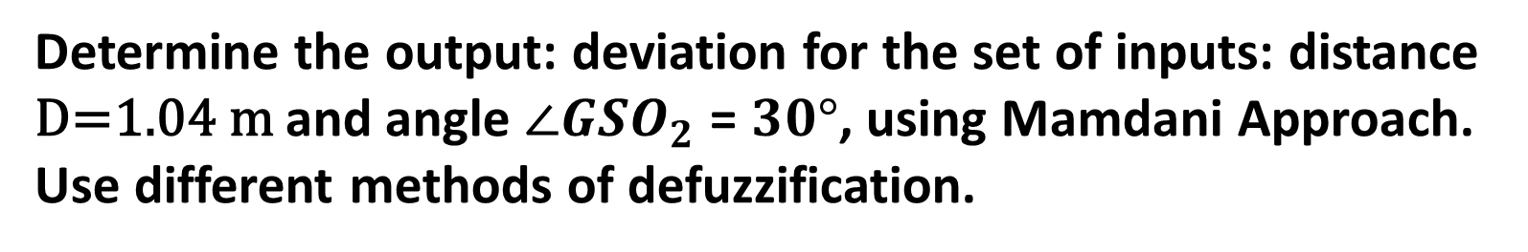
Determine the output: deviation for the set of inputs: distance D=1.04 m and angle $∠{GSO}_{2}$ = $30°$, using Mamdani Approach. Use different methods of defuzzification.

Slide 19
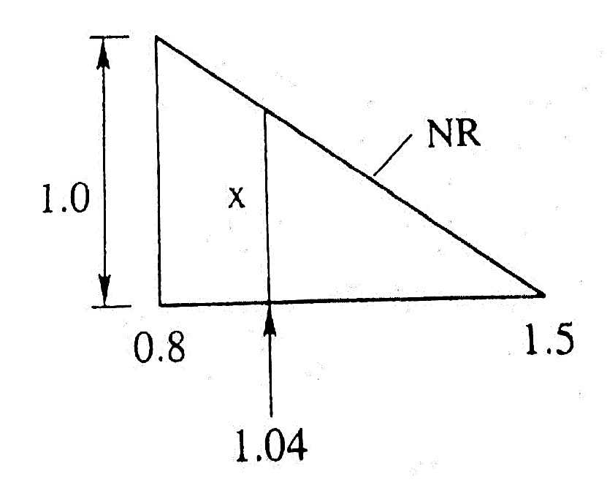
Solution:
Inputs: Distance = 1.04 m; Angle = $30°$
Distance of 1.04 m may be either NR or FR, Angle of $30° may be either A or ART$
To determine the membership, corresponding to the distance = 1.04 m.
$$\frac{x}{1.0}=\frac{1.5−1.04}{1.5−0.8}$$
$$⟹x=0.6571$$

Slide 20
$∴$ Distance of 1.04 m may be called NR with $μ_{NR}=0.6571$ and FR with $μ_{FR}=0.3429$
Similarly, Angle of $30°$ may be declared A with $μ_{A}=0.3333$ and ART with $μ_{ART}=0.6667.$
Fired rules are as follows:
If Distance is NR AND Angle is A Then Deviation is RT
If Distance is NR AND Angle is ART Then Deviation is A
If Distance is FR AND Angle is A Then Deviation is ART
If Distance is FR AND Angle is ART Then Deviation is A

Slide 21
Strengths ($α$ VALUES) of the fired rules:
$${ α}_{1}=\min\left(μ_{NR},μ_{A}\right)=\min\left(0.6571, 0.3333\right)=0.3333$$
${ α}_{2}=\min\left(μ_{NR},μ_{ART}\right)=\min\left(0.6571, 0.6667\right)=0.6571$
$$α_{3}=\min\left(μ_{FR},μ_{A}\right)=\min\left(0.3429, 0.3333\right)=0.3333$$
${ α}_{4}=\min\left(μ_{FR},μ_{ART}\right)=\min\left(0.3429, 0.6667\right)=0.3$429

Slide 22
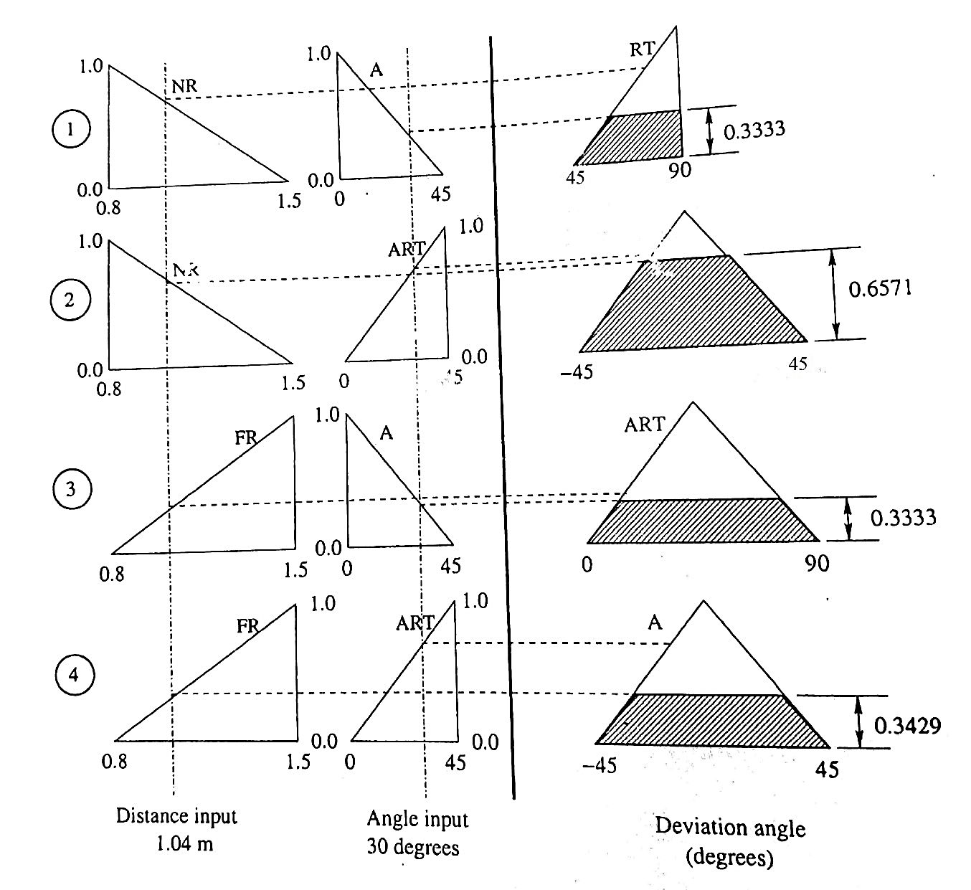
Fuzzified outputs:

Slide 23
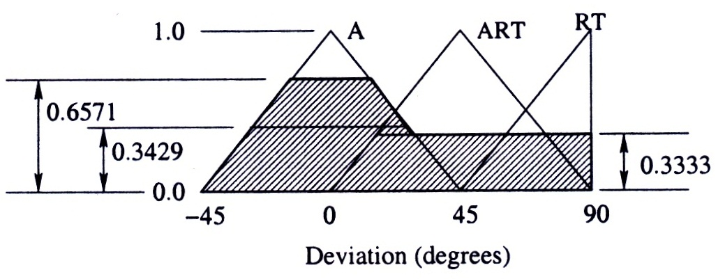
Union of the fuzzified outputs:

Slide 24
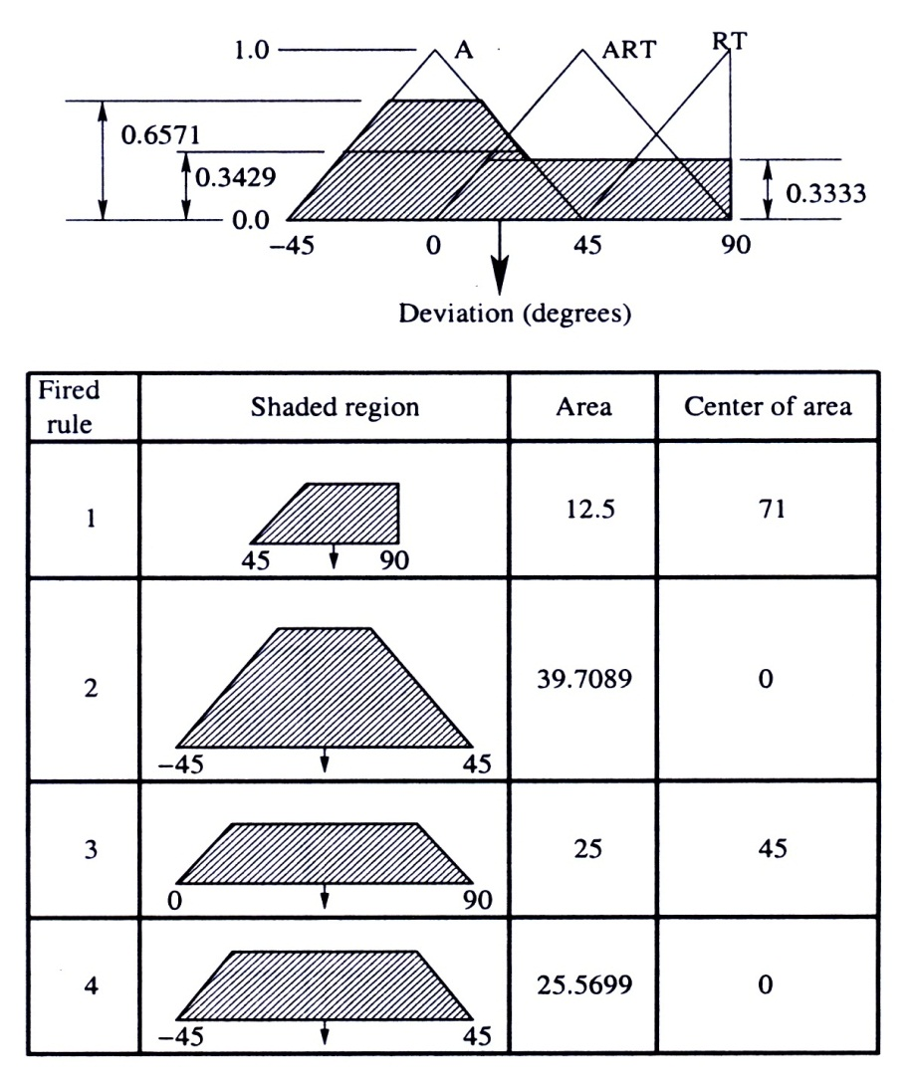
Methods of Defuzzification
1. Center of Sums Method

Slide 26
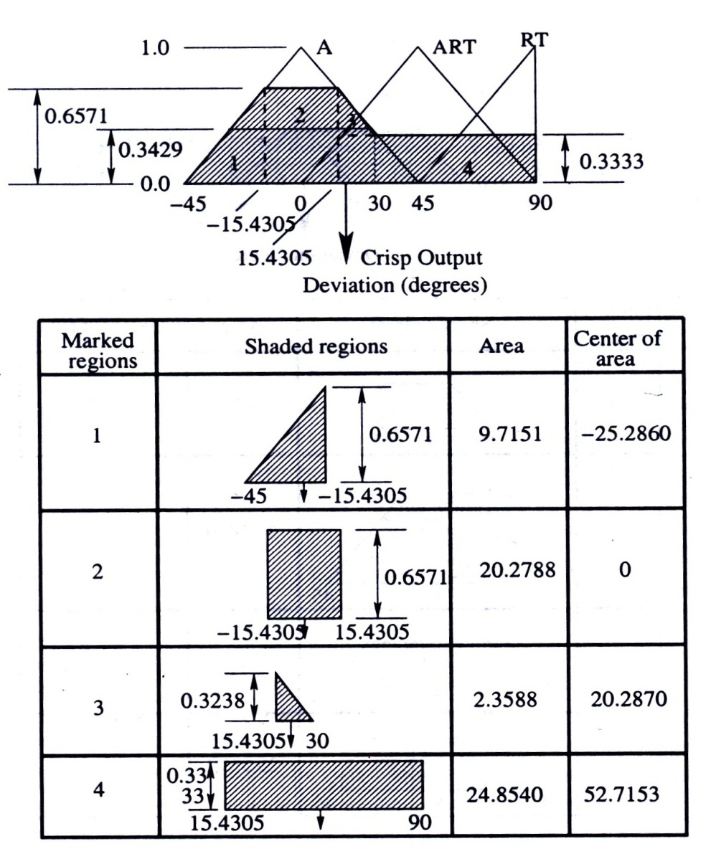
2. Centroid Method

Slide 28
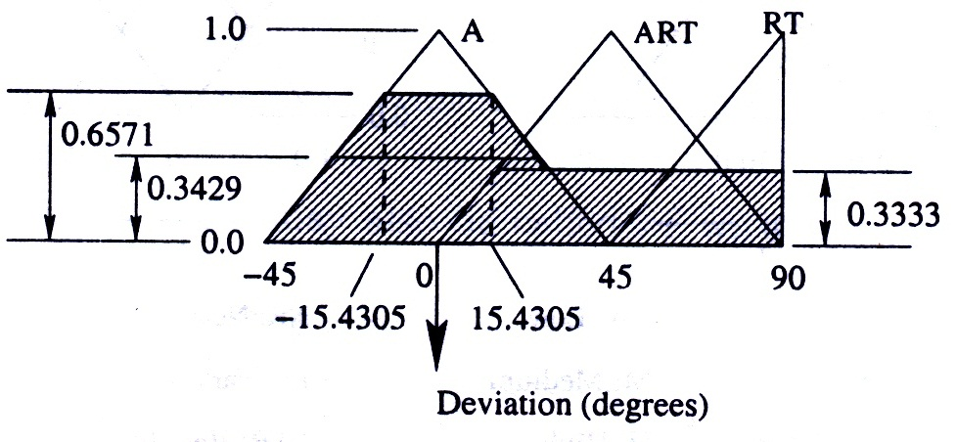
3. Mean of Maxima

Slide 29
Takagi and Sugeno’s Approach
A rule is composed of fuzzy antecedent and functional consequent parts
i-th rule can be represented as follows:
If x₁is A^{i}₁ and x₂ is A^{i}₂ ….. and x_{n} is A^{i}_{n} then
y^{i}=a^{i}₀+a^{i}₁ x₁+……….+a^{i}_{n} x_{n}

Slide 30
where a₀, a₁, …….., a_{n} are the coefficients
A non-linear system is considered to be a combination of several linear systems
Weight of i-th rule can be determined as follows:
w^{i} = μ^{i}_{A1}(x₁) μ^{i}_{A2}(x₂)……… μ^{i}_{An}(x_{n})

Slide 31
Combined control action can be determined as follows:
where k indicates the total number of rules.

Slide 32
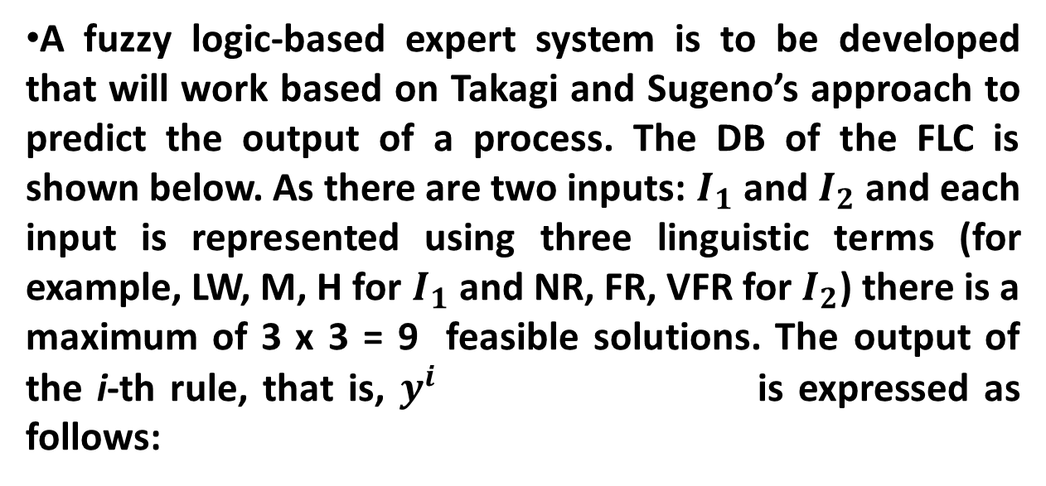
Numerical example (Takagi and Sugeno’s Approach
A fuzzy logic-based expert system is to be developed that will work based on Takagi and Sugeno’s approach to predict the output of a process. The DB of the FLC is shown below. As there are two inputs: $I_{1}$ and $I_{2}$ and each input is represented using three linguistic terms (for example, LW, M, H for $I_{1}$ and NR, FR, VFR for $I_{2}$) there is a maximum of 3 x 3 = 9 feasible solutions. The output of the i-th rule, that is, $y^{i}$ is expressed as follows:

Slide 33
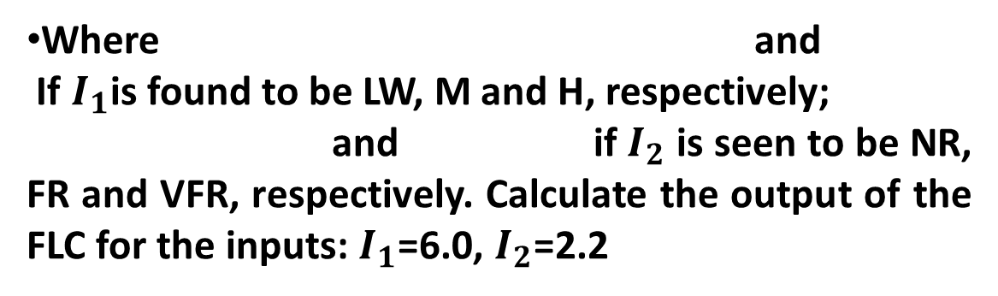
Where and
If $I_{1}$is found to be LW, M and H, respectively;
and if $I_{2}$ is seen to be NR, FR and VFR, respectively. Calculate the output of the FLC for the inputs: $I_{1}$=6.0, $I_{2}$=2.2

Slide 34
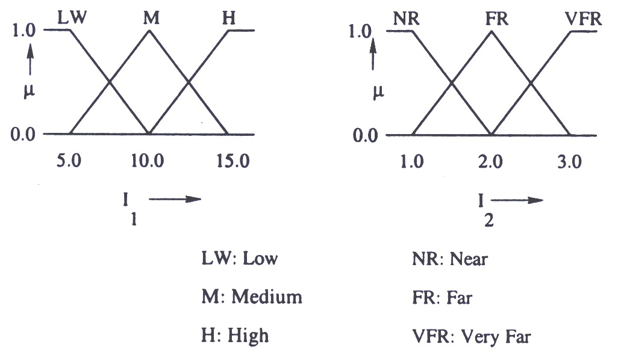

Slide 35
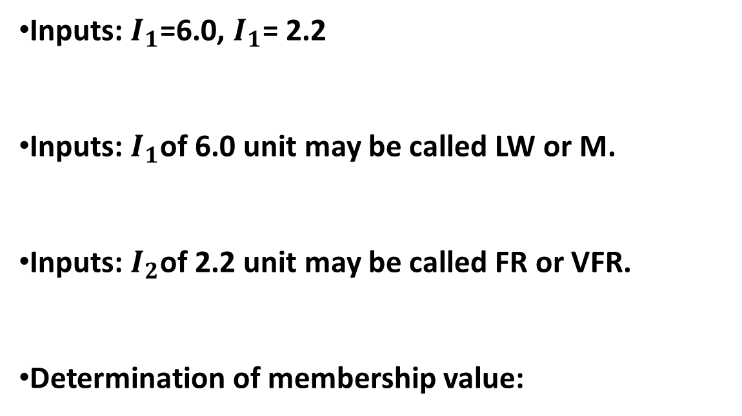
Solution:
Inputs: $I_{1}$=6.0, $I_{1}$= 2.2
Inputs: $I_{1}$of 6.0 unit may be called LW or M.
Inputs: $I_{2}$of 2.2 unit may be called FR or VFR.
Determination of membership value:

Slide 36
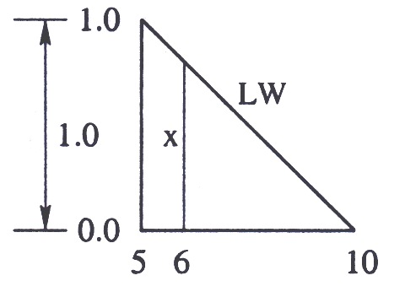
Using the principle of similar triangle

Slide 37
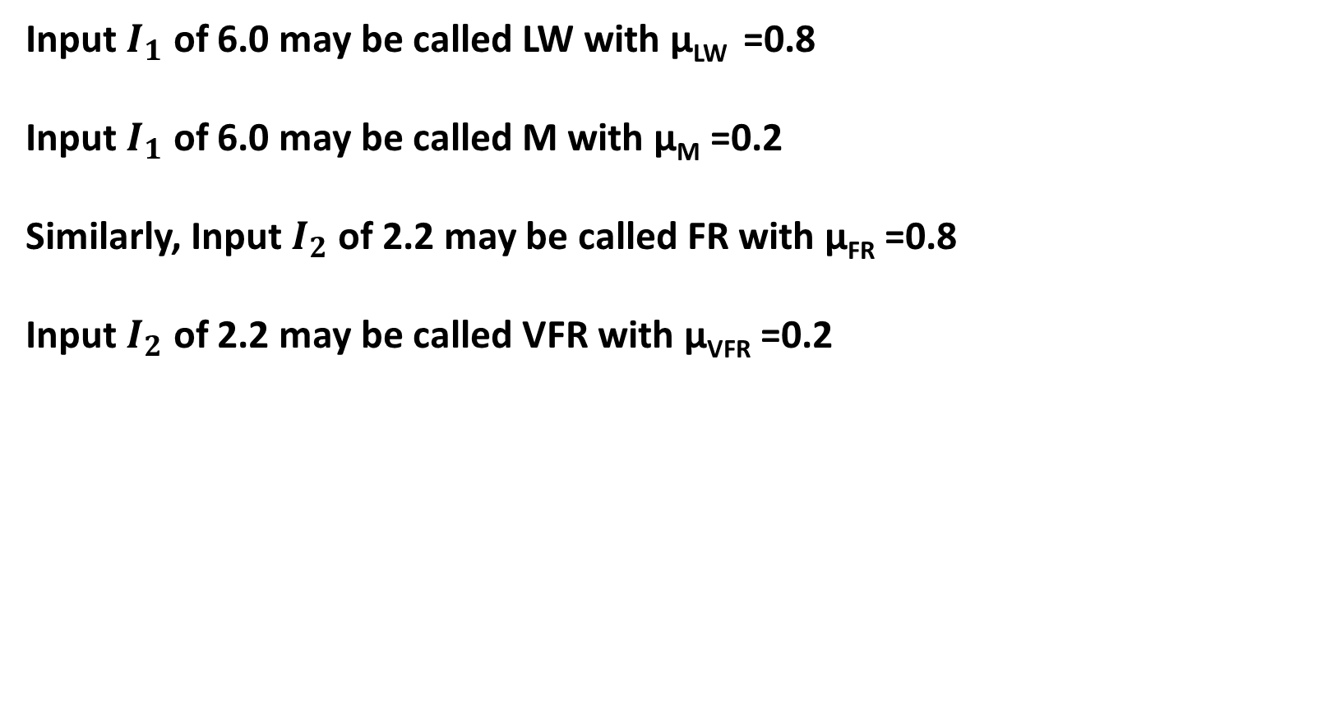
Input $I_{1}$ of 6.0 may be called LW with μ_{LW} =0.8
Input $I_{1}$ of 6.0 may be called M with μ_{M} =0.2
Similarly, Input $I_{2}$ of 2.2 may be called FR with μ_{FR} =0.8
Input $I_{2}$ of 2.2 may be called VFR with μ_{VFR} =0.2

Slide 38
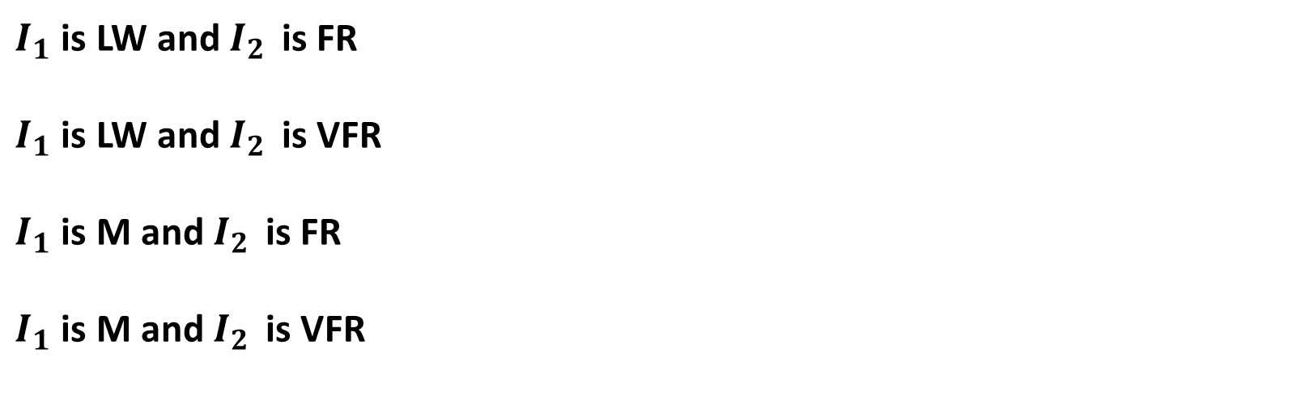
Fired Set of Inputs
$I_{1}$ is LW and $I_{2}$ is FR
$I_{1}$ is LW and $I_{2}$ is VFR
$I_{1}$ is M and $I_{2}$ is FR
$I_{1}$ is M and $I_{2}$ is VFR

Slide 39
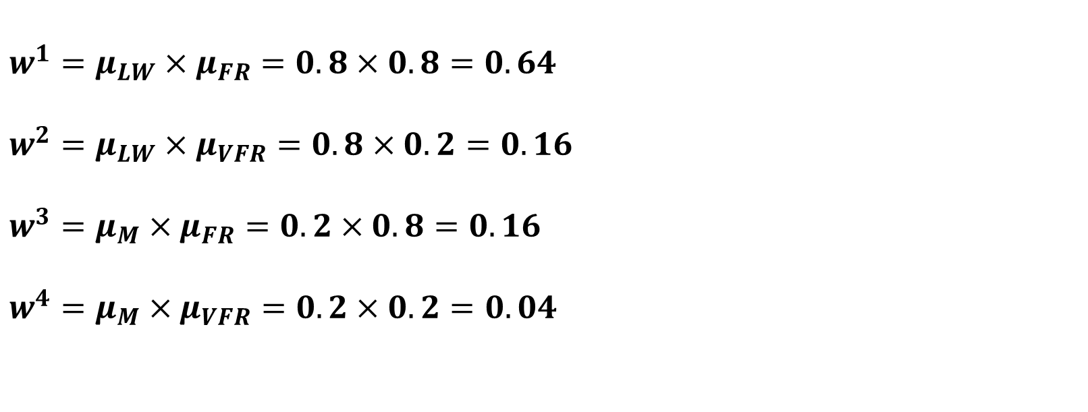
Weights
$$w^{1}=μ_{LW}×μ_{FR}=0.8×0.8=0.64$$
$$w^{2}=μ_{LW}×μ_{VFR}=0.8×0.2=0.16$$
$$w^{3}=μ_{M}×μ_{FR}=0.2×0.8=0.16$$
$$w^{4}=μ_{M}×μ_{VFR}=0.2×0.2=0.04$$

Slide 40
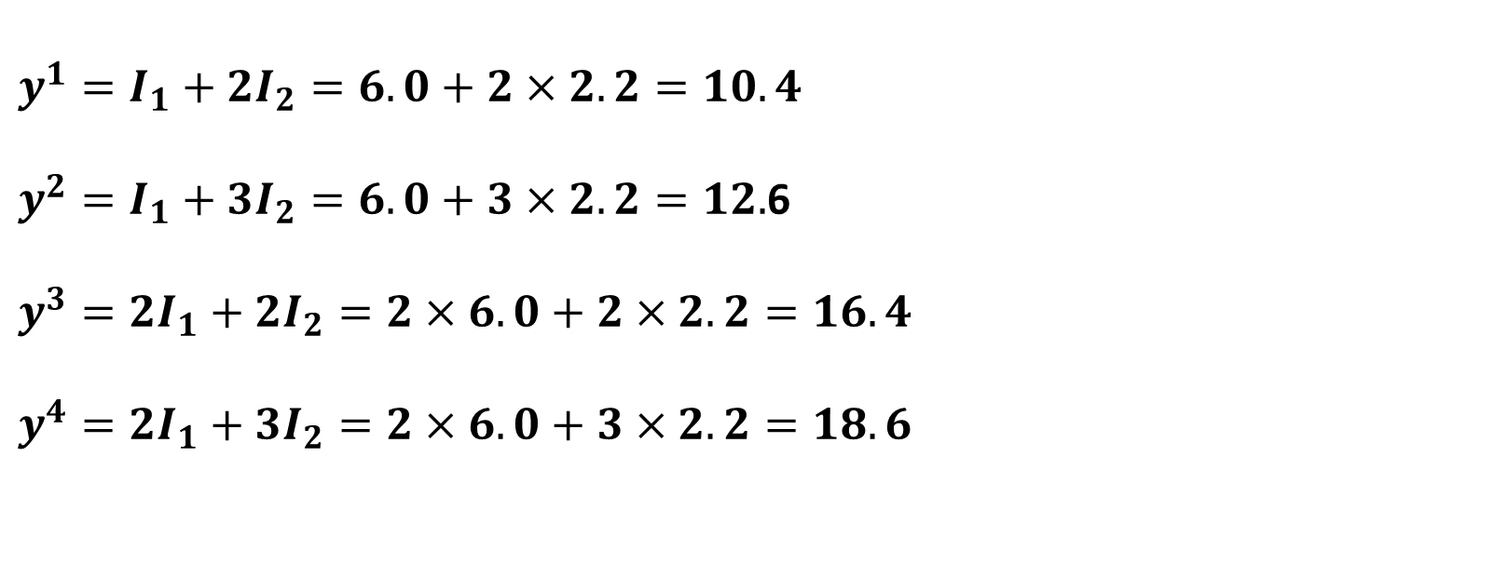
Functional consequent values
$$y^{1}=I_{1}+2I_{2}=6.0+2×2.2=10.4$$
$y^{2}=I_{1}+3I_{2}=6.0+3×2.2=12.$6
$$y^{3}={2I}_{1}+2I_{2}=2×6.0+2×2.2=16.4$$
$$y^{4}={2I}_{1}+3I_{2}=2×6.0+3×2.2=18.6$$

Slide 41
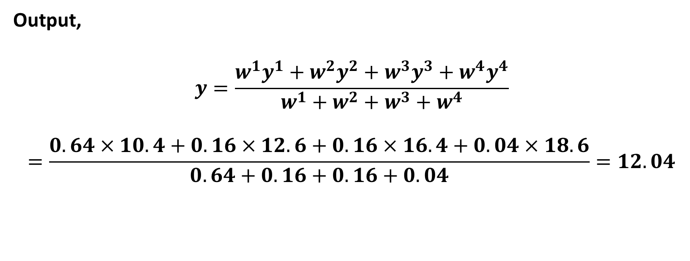
Output,
$$y=\frac{w^{1}y^{1}+w^{2}y^{2}+w^{3}y^{3}+w^{4}y^{4}}{w^{1}+w^{2}+w^{3}+w^{4}}$$
$$=\frac{0.64×10.4+0.16×12.6+0.16×16.4+0.04×18.6}{0.64+0.16+0.16+0.04}=12.04$$

Slide 42
Hierarchical Fuzzy Logic Controller
Let us assume that a process having n inputs (I₁,I₂,……I_{n}) and one output (that is, O) is to be modeled using an FLC

Slide 43
Let us also assume that m linguistic terms (fuzzy sets) are used to represent each variable.
Total no. of rules = m^{n}
Problem : curse of dimensionality

Slide 44
To overcome this problem, we go for Hierarchical Fuzzy Logic Controller
Total no. of rules = m²(n-1)

Slide 45
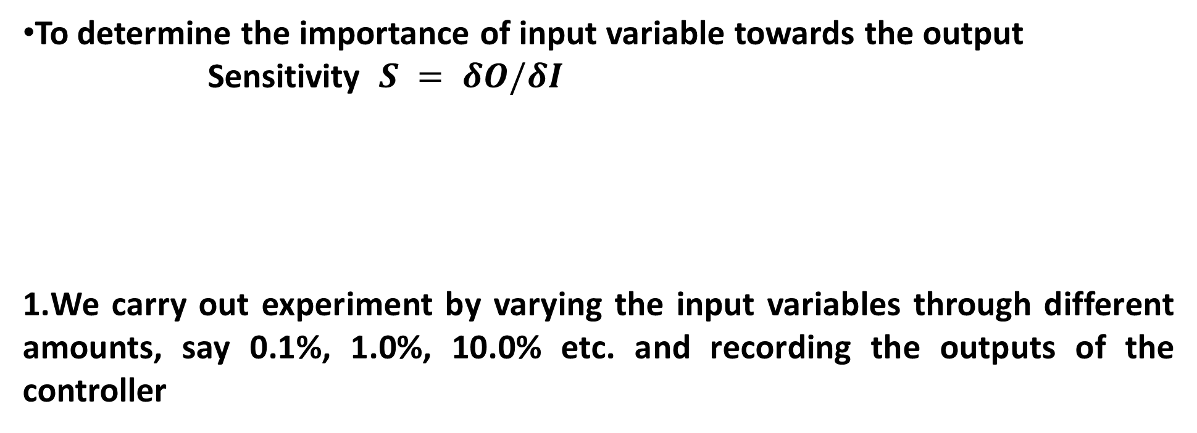
Sensitivity Analysis
To determine the importance of input variable towards the output
Sensitivity $S = δO/δI$
We carry out experiment by varying the input variables through different amounts, say 0.1%, 1.0%, 10.0% etc. and recording the outputs of the controller
Methods to Determine Sensitivity

Slide 46
2.O = f(I₁, I₂)
We change the input I₁ by a small amount δI₁ and determine the change in output using Mean-Value theorem

Slide 47
Where lies between I₁ and I₁+δI₁
If then δO > δI₁
Thus, the contribution of I₁ on the output O can be determined.

Slide 48
Advantages of FLC
Potential tool for dealing with imprecision and uncertainty
Does not require an extensive mathematical formulation of the problem

Slide 49
Disadvantages of FLC
Designing a proper KB of an FLC is a difficult task
May not be suitable for modeling a process involving many variables

